Slide 1
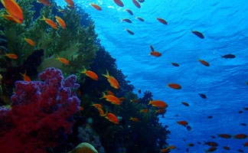
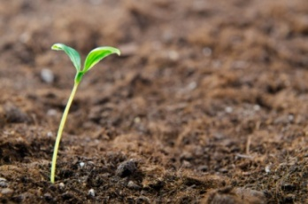
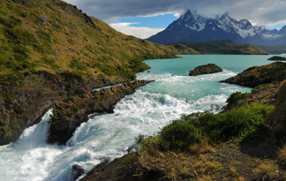
Policy Applications of NCA
Urvashi Narain, Senior Environmental Economist
Agriculture and Environmental Services Department, The World Bank
Istanbul, June 29, 2014

Slide 2
NETHERLANDS Water Profiles: What are the most important users of water? Is their water productivity improving between 2003 and 2010? (liter/ euro of sector value-added)
Source: CBS

Slide 3
Murray-Darling River Basin Australia Benefits from Water Pricing Refor
Based on historical water use & price data, simulated impact
on GDP of doubling water prices and the expected increases in water
use efficiency (WUE) of 1-2%

Slide 4
BOSTWANA Are scarce water resources allocated efficiently?
Source: DWA

Slide 5
Thank you!
www.wavespartnership.org

