Slide 1
What's the policy use of Natural Capital Accounting?
Exploring implications for Turkey
5th World Congress of Environmental and Resource Economists
28th June-2nd July 2014, Istanbul
Ebru Voyvoda
Middle East Technical University, Ankara/TURKEY

Slide 2
Turkey: special circumstances
Turkey in “International action for containing the effects of climate change”
Turkey compared to the core implementing countries of the WAVES (Botswana, Colombia, Costa Rica, Guatemala, Indonesia, Madagascar, the Philippines, Rwanda).
  Not a resource-rich economy
  Economic growth dependent on accumulation of physical and human capital (consumption/ saving – investment, demographics, education policies)
  Implications for the interaction between the economy and environment.

Slide 3
NCA: Exploring Implications for Turkey
Natural Capital Accounting under the SEEA framework:
  Natural resource stocks
  Land
  Ecosystems
w.r.t the functions:
  Resource
  Sink
  Services
Accounting for the “impact of economy on environment”:
  RELATING TO DEPLETION
  RELATING TO DEFENSIVE EXPENDITURES
  RELATING TO DEGREDATION

Slide 4
NCA: Exploring Implications for Turkey
Key Indicators of the interaction between the economy and the environment:
  low per capita CO2 emissions, low CO2 emissions per GDP,
  one of the highest levels of emission intensity (measured by the ratio of CO2 to energy supply)
  Highest (cumulative) growth rate in total emissions: (1) (2) (3)
  Low produced and natural capital, low and declining ANS
  Lower end at “air quality”, middle-low at “water productivity” and lower end at “forest land”.
  Lower end at “marine protection” and “terrestrial protection”.
  Need and Potential for “de-coupling”

Slide 5
NCA: Exploring Implications for Turkey
EU accession process, negotiation on the Environment Chapter (compliance with the EU Environmental Acquis), which offers significant opportunities for greening the economy.
Environmental compliance is neither costless nor easy to achieve.
Turkey has already moved forward on some elements of green growth.
Statistics.
Energy – related issues
  Dependence on Imports
  Change of Ownership (of natural resources and energy supply units **)
  Conflicting goals? Trade-off effects…

Slide 6
NCA: Exploring Implications for Turkey
Daily et al. (2013): Mainstreaming Natural Capital into Decisions

Slide 7
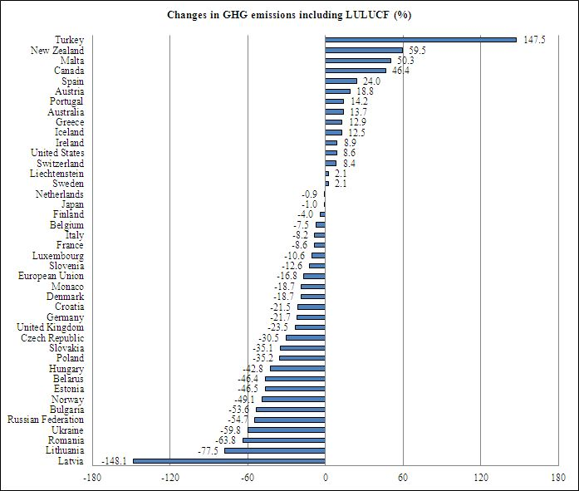

Slide 8
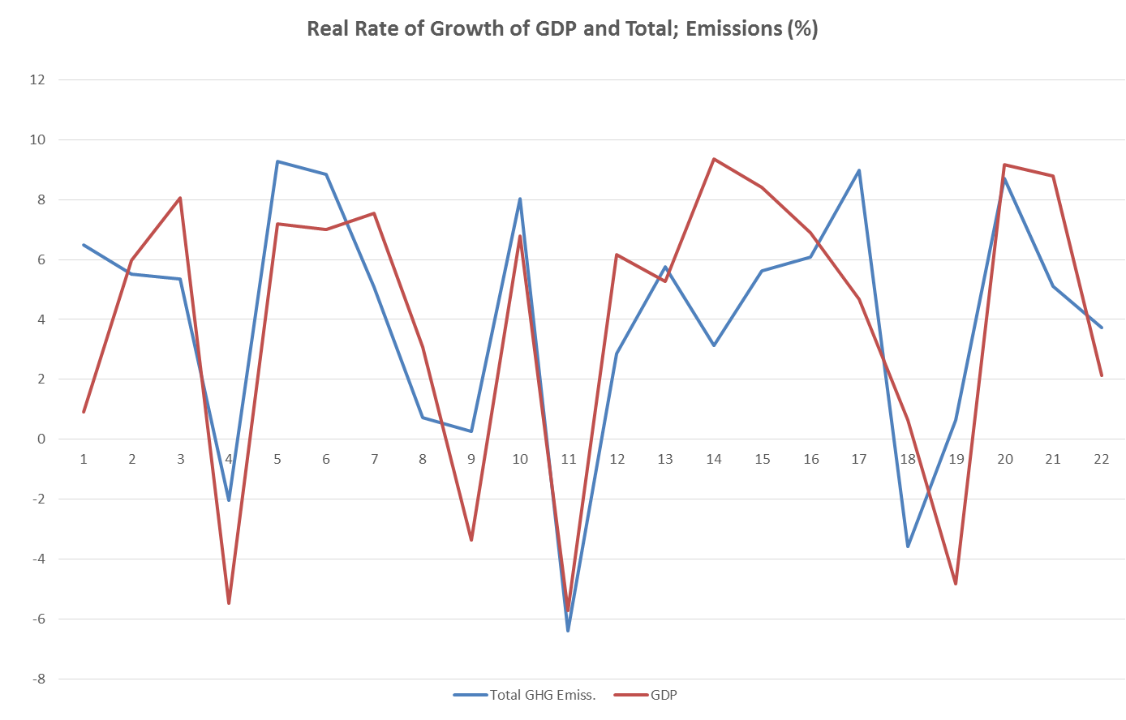

Slide 9
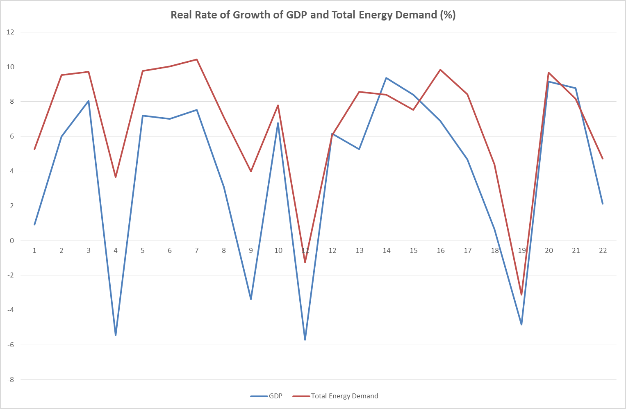

Slide 10
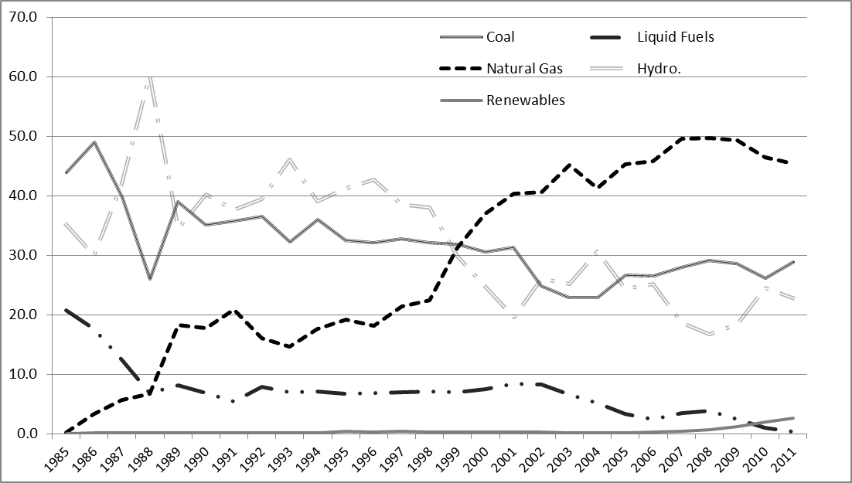
Electricity Production w.r.t primary source (1985-2011)

Slide 11
Kat, Güven ve Voyvoda (2012):
Base Path, Total Energy Supply Shares (%)

